Slide 1
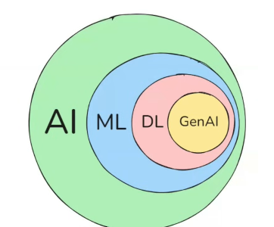

π
HumanInLoop
Langgraph
Human in the Loop
Command Object
Approver.py
Multiturn Conservation.py
Notes:
Content: https://www.linkedin.com/pulse/chunking-strategies-ai-data-kash-kashyap-0lghe/

Slide 2
Human In The Loop
Addition of human checkpoint at specific point in between the LLM Workflow(pipeline)
Review Tool calling
Validating LLM Output

Slide 3
Human In The Loop
Human-In-The-Loop Middleware allow us to add human intervention at any point in an automated process. This is especially useful when a model proposes an action that might require review—for example, writing to a file or executing SQL—the middleware can pause execution and wait for a decision
Use-cases
Reviewing tool calls:
Humans can review, edit or approve tool calls requested by the LLM before tool execution
Validating LLM Outputs: Human can review, edit or approve content generated by the LLM
Providing context : Enable the LLm to explicitly request human input for clarification or addition details or to support multi-turn conversations

Slide 4
There are typically three different actions that you can do with a human-in-the-loop workflow:
1: Approve or Reject:
Pause the graph before a critical step, such as an API call, to review and approve the action.
If the action is rejected, you can prevent the graph from executing the step, and potentially take an alternative action. This pattern often involve routing the graph based on the human's input.
Some Node
Approve
Depending on he human’s approval or rejection, the graph can proceed with the action or take an alternative path
LLM
LLM
Another Node
Reject

Slide 5
2: Review & Edit State
node 2
Human
node 1
A human can review and edit the state of graph. This is useful for correcting mistakes or updating the state with additional information

Slide 6

3: Review Tool Calls
Human
node 1
A human can review and edit the output from LLM proceeding
This is particularly critical in application where the tool calls requested by the LLM may be sensitive or require human oversight

Slide 7
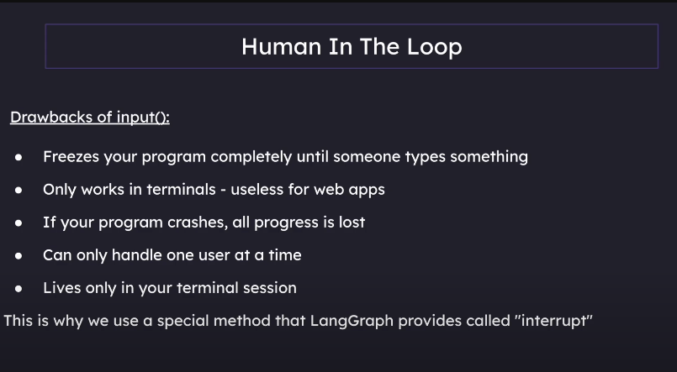
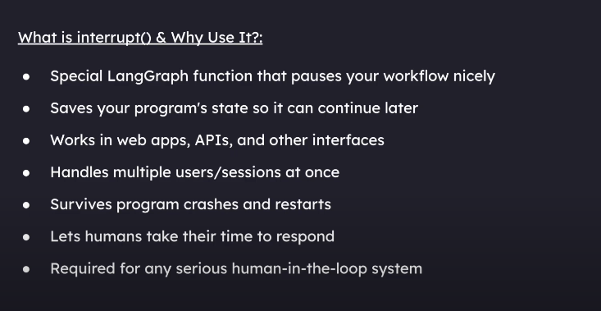

Slide 8
Human In The Loop
Two way of using interrupt
Human_review= interrupt(
{
"generated_post": generated_post, "message": "Provide feedback or type 'done' to finish“
}
)
app=graph.compile(
checkpointer=memory, interrupt_before=["tools"]
)
If review_action == “continue” :
Command( goto=“run_tools")
Interrupt in compile step
Interrupt function with Command class

Slide 9
Command object
from typing import TypedDict
from langgraph.graph import StateGraph, END
from langgraph.types import Command
class BaiscChatState(TypedDict):
text: str
def node_a(state: BaiscChatState):
print("node_a")
return Command( goto="node_b", update={ "text": state["text"] + 'a' } )
def node_b(state: BaiscChatState):
print("node_b")
return Command( goto="node_c", update={ "text": state["text"] + 'b' } )
def node_c(state: BaiscChatState):
print("node_c")
return Command( goto="node_d", update={ "text": state["text"] + 'c' } )
graph = StateGraph(BaiscChatState)
graph.add_node("node_a", node_a)
graph.add_node("node_b", node_b)
graph.add_node("node_c", node_c)
graph.set_entry_point("node_a")
app = graph.compile()
result = app.invoke({"text": ""})
result

Slide 10
Interrupts
Operations with Interrupts:
Resume – Continue execution with input from the user without modifying the state
Update and Resume – Update the state and then continue execution
Rewind / Time Travel – Go back to a previous checkpoint in the execution
Branch – Create a new branch from the current execution state to explore alternative paths
Abort – Cancel the current execution entirely
Each of these operations gives you different ways to control the flow of your graph interrupted.

Slide 11
from typing import TypedDict
from langgraph.graph import StateGraph, END
from langgraph.types import Command
from langgraph.checkpoint.memory import MemorySaver
class BaiscChatState(TypedDict):
text: str
1
def node_a(state: BaiscChatState):
print("node_a")
return Command( goto="node_b", update={ "text": state["text"] + 'a' } )
def node_b(state: BaiscChatState):
print("node_b")
human_response = interrupt("do you want to go on C or D node?")
print("Human Review Values: ", human_response)
if human_response == "C":
return Command( goto="node_c", update={ "text": state["text"] + 'b' } )
elif human_response == "D":
return Command( goto="node_d", update={ "text": state["text"] + 'b' } )
def node_c(state: BaiscChatState):
print("node_c")
return Command( goto="node_d", update={ "text": state["text"] + 'c' } )
def node_d(state: BaiscChatState):
print("node_d")
return Command( goto=END, update={ "text": state["text"] + 'd' } )
2

Slide 12
graph = StateGraph(BaiscChatState)
graph.add_node("node_a", node_a)
graph.add_node("node_b", node_b)
graph.add_node("node_c", node_c)
graph.add_node("node_d", node_d)
graph.set_entry_point("node_a")
app = graph.compile( checkpointer=memory)
result = app.invoke({"text": ""}) result
config = { "configurable": { "thread_id“ : "1“ }}
initialstate = { "text“ : "“ }
result = app.invoke(initialstate,config=config,
stream_mode="updates")
# print(app.get_state(config=config).next)
3
node_a
node_b
second_result=app.invoke(Command(resume="D"),config=config,stream_mode="updates")
second_result
4
node_b
Human Review Values: D
node_d
[{'node_b': {'text': 'ab'}}, {'node_d': {'text': 'aabd'}}]

Slide 13
Command Object
Command object(is a new tool) in Langgraph
that allows us to manage dynamic, edgeless agent flows. it means, nodes can dynamically decide which node to execute next
# With type hints, you can specify the possible nodes this can go to.
def agent(state: MessagesState) -> Command[Literal[..., END]]:
...
return Command(
goto=“node_b”, # The next node(s) to go to
update={ "messages": [response]} # The update to apply to the state
)
(goto) : Tells the graph which node to run next. Example: "node_b" or END.
(update) : Specifies how the graph’s state should be modified before moving forward.

Slide 14
from langgraph.graph import StateGraph, MessagesState
from langgraph.types import Command
from langchain_core.messages import HumanMessage
def node_a(state: MessagesState):
return Command( goto="node_b", update=state["messages"].append("node_a") )
def node_b(state: MessagesState):
return Command( goto="node_c", update=state["messages"].append("node_b") )
def node_c(state: MessagesState):
return Command( goto=END, update=state["messages"].append("node_c") )
builder = StateGraph(MessagesState)
builder.add_node("node_a", node_a)
builder.add_node("node_b", node_b)
builder.add_node("node_c", node_c)
builder.set_entry_point("node_a")
app = builder.compile()
res = app.invoke({"messages": [HumanMessage(content="hello boss")]})

Slide 15
from langgraph.graph import StateGraph, START, END, add_messages
from typing import TypedDict, Annotated, List
from langgraph.checkpoint.memory import MemorySaver
from langchain_openai import AzureChatOpenAI
from langchain_community.tools import TavilySearchResults
from langgraph.prebuilt import ToolNode
from langchain_core.messages import HumanMessage
from dotenv import load_dotenv,find_dotenv
import os
load_dotenv(find_dotenv(),override=True)
endpoint = os.getenv("AZURE_OPENAI_ENDPOINT")
subscription_key = os.getenv("AZURE_OPENAI_API_KEY")
api_version="2025-01-01-preview"
memory=MemorySaver()
search_tool=TavilySearchResults(max_results=2)
tools=[search_tool]
llm_with_tools = AzureChatOpenAI(azure_endpoint=endpoint,api_key=subscription_key,
api_version=api_version).bind_tools(tools)

Slide 16
class BasicState(TypedDict): messages: Annotated[List, add_messages]
def model(state: BasicState):
return { "messages": [llm_with_tools.invoke(state["messages"])] }
def tools_router(state: BasicState):
last_message = state["messages"][-1]
if(hasattr(last_message, "tool_calls") and len(last_message.tool_calls) > 0):
return "tools"
else:
return END
graph = StateGraph(BasicState)
graph.add_node(model, "model")
graph.add_node("tools", ToolNode(tools=tools))
graph.set_entry_point("model")
graph.add_conditional_edges("model", tools_router)
graph.add_edge("tools", "model")
app = graph.compile(checkpointer=memory, interrupt_before=["tools"])
config = {"configurable": { "thread_id": 1 }}

Slide 17
events = app.stream({
"messages": [HumanMessage(content="What is the current weather in Chennai?")]
}, config=config, stream_mode="values")
for event in events:
event["messages"][-1].pretty_print()
===============================Human Message=================================
What is the current weather in Chennai?
==================================Ai Message ==================================
Tool Calls:
tavily_search_results_json (call_4m9xaenAMciLd6r5ekUz9DXH)
Call ID: call_4m9xaenAMciLd6r5ekUz9DXH
Args:
query: current weather in Chennai

Slide 18
events = app.stream(None, config=config, stream_mode="values")
for event in events:
event["messages"][-1].pretty_print()
Passing None as input means you’re resuming from a checkpoint or continuing an existing thread.
================================== Ai Message ==================================
Tool Calls:
tavily_search_results_json (call_kWltstW28VK0YVjbZr9WFUfX)
Call ID: call_kWltstW28VK0YVjbZr9WFUfX
Args:
query: current weather in Chennai
================================= Tool Message =================================
Name: tavily_search_results_json
================================== Ai Message ==================================
Today, Chennai is experiencing a warm and humid day with temperatures ranging from 25°C to 38°C.

Slide 19
from dotenv import load_dotenv,find_dotenv
import os,uuid
from langgraph.graph import StateGraph,END,START,add_messages
from typing import TypedDict,List,Annotated
from langchain_openai import AzureChatOpenAI
from langgraph.checkpoint.memory import MemorySaver
from langchain_core.messages import SystemMessage, HumanMessage,AIMessage
from langgraph.types import interrupt,Command
load_dotenv(find_dotenv(),True)
endpoint = os.getenv("AZURE_OPENAI_ENDPOINT")
subscription_key = os.getenv("AZURE_OPENAI_API_KEY")
api_version="2025-01-01-preview"
memory=MemorySaver()
llm = AzureChatOpenAI(azure_endpoint=endpoint,api_key=subscription_key, api_version=api_version)
class State(TypedDict):
linkedin_topic: str
generated_post: Annotated[List[str], add_messages]
human_feedback: Annotated[List[str], add_messages]
1-Multiturn Conservation

Slide 20
def model(state: State) -> str:
linkedin_topic = state["linkedin_topic"]
feedback = state.get("human_feedback", ["No Feedback yet"])
prompt = f""" LinkedIn Topic: {linkedin_topic} Human Feedback: {feedback[-1] if feedback else "No feedback yet"}
Generate a structured and well-written LinkedIn post based on the given topic. Consider previous human feedback to refine the reponse. """
response = llm.invoke([ SystemMessage(content="You are an expert LinkedIn content writer"), HumanMessage(content=prompt) ])
generated_linkedin_post = response.content
return { "generated_post": [AIMessage(content=generated_linkedin_post)] , "human_feedback": feedback }
def human_node(state: State):
generated_post = state["generated_post"]
# Interrupt to get user feedback
user_feedback = interrupt( { "generated_post": generated_post, "message": "Provide feedback or type 'done' to finish" } )
print(f"[human_node] Received human feedback: {user_feedback}")
if user_feedback.lower() == "done":
return Command(update={"human_feedback": state["human_feedback"] + ["Finalised"]}, goto="end_node")
return Command(update={"human_feedback": state["human_feedback"] + [user_feedback]}, goto="model")
2-Multiturn Conservation

Slide 21
def end_node(state: State):
print("\n[end_node] Process finished")
print("Final Generated Post:", state["generated_post"][-1])
print("Final Human Feedback", state["human_feedback"])
return {
"generated_post": state["generated_post"],
"human_feedback": state["human_feedback"]
}
3-Multiturn Conservation

Slide 22
graph = StateGraph(State)
graph.add_node("model", model)
graph.add_node("human_node", human_node)
graph.add_node("end_node", end_node)
graph.set_entry_point("model")
# Define the flow
graph.add_edge(START, "model")
graph.add_edge("model", "human_node")
graph.set_finish_point("end_node")
# Enable Interrupt mechanism
checkpointer = MemorySaver()
app = graph.compile(checkpointer=checkpointer) thread_
config = {"configurable": { "thread_id": uuid.uuid4() }}
linkedin_topic = input("Enter your LinkedIn topic: ")
initial_state = { "linkedin_topic": linkedin_topic, "generated_post": [], "human_feedback": [] }
4-Multiturn Conservation

Slide 23
for chunk in app.stream(initial_state, config=thread_config):
for node_id, value in chunk.items():
# If we reach an interrupt, continuously ask for human feedback
if(node_id == "__interrupt__"):
while True:
user_feedback = input("Provide feedback (or type 'done' when finished): ")
# Resume the graph execution with the user's feedback app.invoke(Command(resume=user_feedback), config=thread_config)
# Exit loop if user says done
if user_feedback.lower() == "done":
break
5-Multiturn Conservation

